Slide 1


CSE 455 Software Testing
Lecture 11
This course is offered to the students of students of BS Software Engineering who are enrolled in 8th semester

Slide 2
Course instructor Yella mehroze
yellamehroze@cuilahore.edu.pk

Slide 3
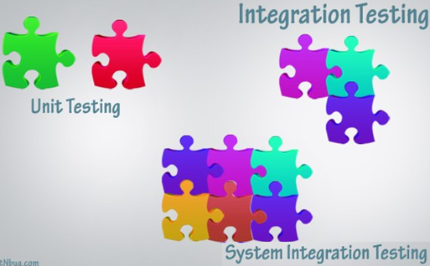
Unit, integration and system test
Notes:
NOTE:
To change the image on this slide, select the picture and delete it. Then click the Pictures icon in the placeholder to insert your own image.

Slide 4
Unit Testing
Unit Testing is a software development process in which the smallest testable parts of an application, called units, are individually and independently examined for proper operation. Unit testing is often automated but it can also be done manually.
Usually performed by the programmer who writes the program unit
Unit testing is conducted in two phases:
Static unit testing
Dynamic unit testing

Slide 5
Unit Testing
Static Unit Testing-in which a programmer does not execute the unit; instead, the code is examined over all possible behaviors that might arise during run time.
In static unit testing, code is reviewed by applying following techniques
Inspection
Walkthrough
Dynamic Unit Testing- Selection of test data is broadly based on the following techniques:
Control Flow Testing (Path Testing)
Data Flow Testing
Domain Testing
Functional Program Testing

Slide 6
Unit Testing
Control Flow Testing (Path Testing)
These techniques are based on selecting a set of test paths through the program. E.g., pick enough paths to assure that every source statement is executed at least once.
Data flow testing
It is a family of test strategies based on selecting paths through the program's control flow in order to explore sequences of events related to the status of variables or data objects. Dataflow Testing focuses on the points at which variables receive values and the points at which these values are used.
Domain testing
It is a software testing technique in which we select a small number of test cases from a nearly infinite group of test cases. In Domain Testing, we partition a domain into sub-domains (equivalence classes) and then test using values from each sub-domain.

Slide 7
Unit Testing - Example
Public int A(int a,int b)
{
if (a%2==0)
return a;
else
return b;
}
Public int B (int a,int b,int c)
{
int val=A(a,b);
val=A(val,c);
}
Perform UT for function A & B so that the coverage is100%

Slide 8
Unit Testing - Example
Test Case ID | Description | Input Data | Expected Results | Actual Results | Pass / Fail | Remarks
UT-01 | To test A function when a is even | 2 , 3 | 2 | 2 | Pass | -
UT-02 | To test A function when a is odd | 1 , 2 | 2 | 2 | Pass | -
UT-03 | To test B function providing any 3 values | 2 , 3 , 4 | 2 | 2 | Pass | -
If only UT for function B is done then the coverage of function A is 50%. Why?

Slide 9
Integration Testing
Integration Testing- testing the interaction between the modules and interaction with other systems is called integration testing
It starts when two of the product components are available
It ends when all component interfaces have been tested
The final round of integration involving all components is called Final Integration Testing

Slide 10
Integration Testing
Integration testing means testing of interfaces
Interfaces are of following two types
Internal Interface- are those that provide communication across two modules with in a product and not exposed to customers
One method is by providing Application Programming Interfaces (APIs)
Other means of integration may include function calls, public functions, global variables
Some other means may be operating system constructs like semaphores (abstract data type) and shared memory
All interfaces may not be available at the same time for testing purposes
To test interfaces, when the full functionality of the component is not available, stubs are provided
Stub simulates the interface by providing the appropriate values in the appropriate format as would be provided by the actual component being integrated

Slide 11
Integration Testing
External (Exported) Interfaces- are for third party developers or other users outside the group
Initially external interfaces were provided through API’s and Software Development Kit (SDK)
Now testing of the various scenarios of usage of interface has increased significantly because of the widespread implementation of the interfaces
Now the interfaces are available through scripting languages without the need for SDK
All interactions between modules are not known and explained through interfaces
Some of the interfaces are documented and some are not. According to this concept there are two classifications of interfaces
Explicit Interfaces- documented interfaces
Implicit Interface- known internally to software engineers but are not documented

Slide 12
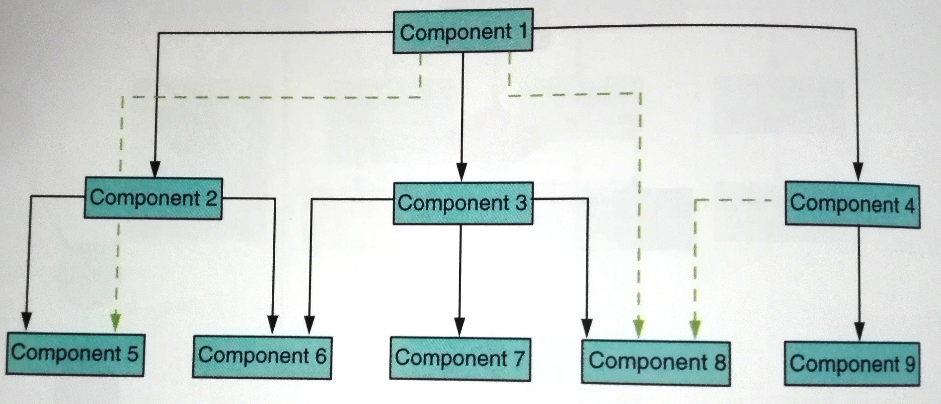
Set of Modules and Interfaces
Solid lines represent explicit interfaces
Dotted lines represent implicit interfaces
There are 12 interface in the diagram (9 explicit and 3 implicit)

Slide 13
Integration Testing
To decide, in what order the interfaces need to be tested, there are following methodologies
Big bang approach
Top-down Integration
Bottom-up Integration
Bi-directional Integration
System Integration

Slide 14
Big bang Integration
Non incremental
Module 1
Module 2
Module 6
System
Module 3
Module 5
Module 4

Slide 15
Top-down Integration
This integration testing involves testing topmost component interface with other components in the same order as you navigate from top to bottom, till you cover all the components
If a set of components and their related interfaces can deliver functionality without expecting the presence of other components and their interfaces then it is called sub-system
In top-down testing, the first module tested is the main module, the highest level module in the software structure; the last modules to be tested are the lowest level modules.

Slide 16
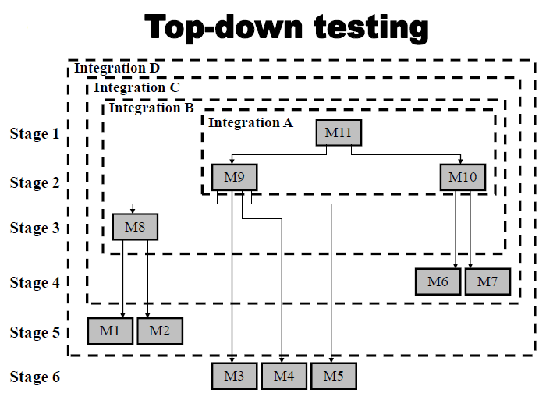
Example of Top-down Integration

Slide 17
Order of testing interfaces for the example Horizontally Covered
Stage 1: Unit tests of module 11.
Stage 2: Integration test A of module 11 integrated with modules 9 and 10, developed in the current stage.
Stage 3: Integration test B of A integrated with module 8, developed in
the current stage.
Stage 4: Integration test C of B integrated with modules 6 and 7, developed in the current stage.
Stage 5: Integration test D of C integrated with modules 1 and 2, developed in the current stage.
Stage 6: System test of D integrated with modules 3, 4 and 5, developed in the current stage.

Slide 18
Order of testing interfaces for the example Vertically Covered
Stage 1: Unit tests of module 11.
Stage 2: Integration test A of the integration of module 11 with module 9, developed in the current stage.
Stage 3: Integration test B of A with module 8, developed in the current stage.
Stage 4: Integration test C of B with modules 1 and 2, developed in the current stage.
Stage 5: Integration test D of C with module 10, developed in the current stage.
Stage 6: Integration test E of integration D with modules 6 and 7, developed in the current stage.
Stage 7: System test is performed after E has been integrated with modules 3, 4 and 5, developed in the current stage.

Slide 19
Top-down Integration
In case of incremental product development, integration testing methodology pertains only to those interfaces that are added
All steps need not to be repeated
Some steps can be combined but this does not mean reduction in the number of test cases tested
It just means an optimization in the elapsed time

Slide 20
Bottom-up Integration
Components for a new product development become available starting from the bottom
In bottom-up testing, the order of testing is reversed: the lowest level modules are tested first, with the main module tested last.
These lower level units are frequently referred to as utility modules.

Slide 21
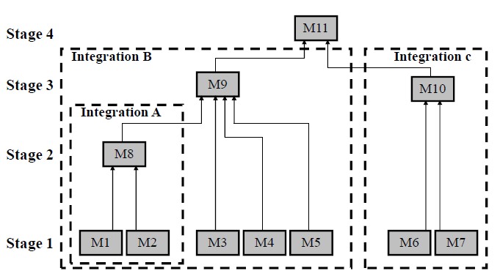
Bottom-up Integration Example

Slide 22
Bottom-up Integration
Stage 1: Unit tests of modules 1 to 7.
Stage 2: Integration test A of modules 1 and 2, developed and tested in stage 1, and integrated with module 8, developed in the current stage.
Stage 3: Two separate integration tests, B, on modules 3, 4, 5 and 8, integrated with module 9, and C, for modules 6 and 7, integrated with module 10.
Stage 4: System test is performed after B and C have been integrated with module 11, developed in the current stage.

Slide 23
Bi-Directional Integration
It is a combination of the top-down and bottom-up integration approaches used together to derive integration steps
A target layer is defined in the middle of the program and testing is carried out from the top and bottom layers to converge at this target layer.
However, it can be more complex to plan and selecting the best target layer can be difficult.
It is performed initially with the use of stubs and drivers
Stubs and drivers are software replacement simulators required for modules not available when performing a unit or integration test
Stubs provide down stream connectivity and stimulate the behavior of a missing component
Stubs are required for top down testing of incomplete systems

Slide 24
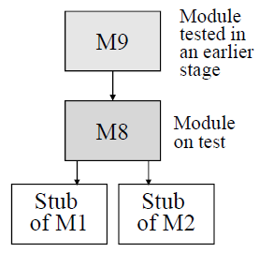
Top Down Tests (Stage 3 of the previous example)
Upper module 9 which activates module 8, is available; it has been tested and corrected at stage 2 of the testing.
Stubs are required to substitute for the subroutine level modules 1 and 2, which have not been completed.

Slide 25
Bi-Directional Integration
Drivers are used to provide upstream connectivity.
A driver is a substitute module but of the upper level module that activates the module tested
The driver is passing the test data on to the tested module and accepting the results calculated by it
Required in bottom up testing until the upper level modules are developed

Slide 26
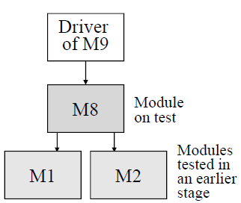
Bi-Directional Integration
At stage 2 lower level modules 1 and 2 are available; they have been tested and corrected at stage 1 of testing
A driver is required to substitute for upper level module 9, which has not been completed

Slide 27
Bi-Directional Integration
After the functionality of these integrated components is tested, the drivers and stubs are discarded
This approach is also called sandwich integration

Slide 28
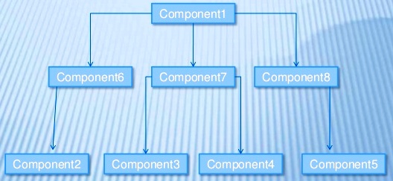
Bi-Directional Integration Example

Slide 29
Steps for integration using sandwich testing
Step | Interfaces Tested
1 | 2-6
2 | 3-4-7
3 | 5-8
4 | (1-6-2)- (1-7-3-4)- (1-8-5)

Slide 30
Bottom-up versus top-down strategies
Advantage of the bottom-up strategy is the relative ease of its performance, whereas the main disadvantage is the lateness at which the program as a whole can be observed (that is, at the stage following testing of the last module)
The main advantage of the top-down strategy is the possibilities it offers to demonstrate the entire program functions shortly after activation of the upper-level modules has been completed
In many cases, this characteristic allows for early identification of analysis and design errors related to algorithms, functional requirements, and the like.

Slide 31
Bottom-up versus top-down strategies
The main disadvantage of top down strategy is the relative difficulty of preparing the required stubs, which often require very complicated programming
It is relatively difficult to analyze the results of the tests
Top down integration leaves utility modules until the end, so that problems with these won't be detected early. If bottom-up integration is used then these might be found soon after integration testing begins.
Top down integration also has disadvantage when the lower layers are finally added the upper layers may need to be retested.

Slide 32
System Integration
All the components of the system are integrated and tested as a single unit as per SRS
System testing enables us to test, verify and validate both the business requirements and application architecture.
Integration testing can be divided into
Components or sub-system integration
Final integration testing or system integration
Complete system integration is covered as the last step
This approach waits till all components arrive and one round of integration testing is done. This approach is called big-bang integration
It reduces testing effort and removes duplication in testing

Slide 33
System Integration
Some disadvantages of system integration are
When a failure or defect is encountered during system integration, it is very difficult to locate the problem
The ownership for correcting the root cause of the defect may be a difficult issue to pinpoint
When integration testing happens in the end, the pressure from approaching the release date is very high
A certain component may take an excessive amount of time to be ready

Slide 34
Choosing Integration Method
Top-down approach is best suited for the waterfall and V
Bottom-up approach is best for iterative and agile methodologies
The selection of integration approach needs to consider availability of components, technology used, process, testing skills, and resource availability
Strategy chosen is actually determined in most cases by the developers’ choice of development – not test strategy, that is, bottom-up or top-down.
Testers should follow the developers’ approach because it is crucial that testing will be performed immediately after a module has been coded
Implementation of a testing strategy that differs from the development strategy will cause substantial delays in scheduling of the tests

